Slide 2
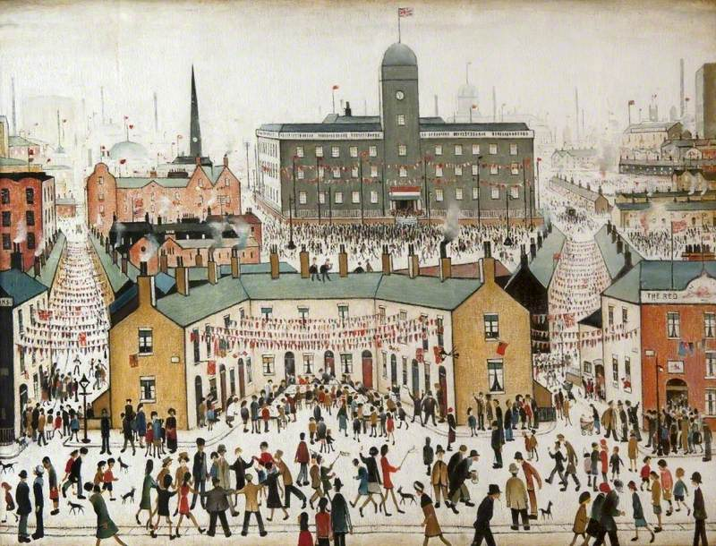
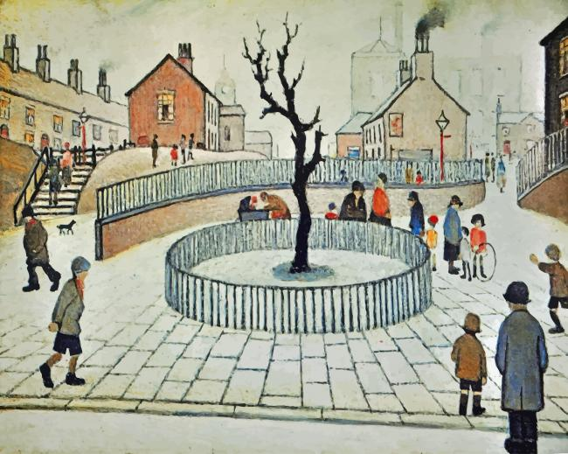
Lowry Class
Kimberlie Blaney
TLA’s: Tracey, Ayisha
kblaney@millfields.hackney.sch.uk
Class Teacher

Slide 3
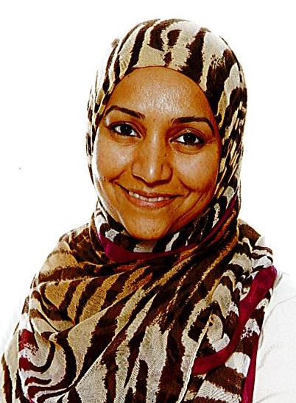
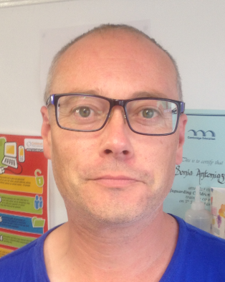
amohi@millfields.hackney.sch.uk
Phase Lead for Key Stage 1
kfry@millfields.hackney.sch.uk
SENCO - Special educational needs coordinator

Slide 4
We will discuss:
Year 1 in 2022-2023
Curriculum
Homework
Communication
Questions

Slide 5
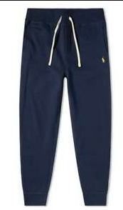
PE days and kit
Lowry have PE on the following days:
Thursday and Friday
Please ensure that your child comes to school wearing their PE kit on these days.

Slide 6
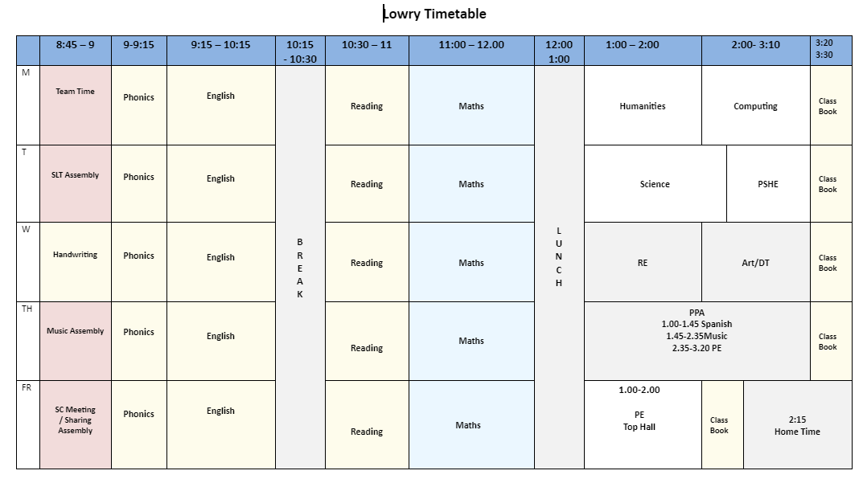
Year 1 Example Timetable

Slide 7
Year 1 Curriculum

Slide 8
Autumn Term
Music
“Sounds Interesting” (duration)
Winter and Nativity concert preparation
RE
Christian Harvest Festival
How and why do Christians celebrate Christmas?
Science
Animals including Humans
PE and Games
Dance
Yoga
Computing
E-safety
Programming
Year 1 Autumn Term
Me and My World
Art and Design
Drawing and Mark making
Sewing
PHSE and Citizenship
Class Charter
Respect and Relationships
Exercise and Outdoors
Geography
Knowing our local area.
Comparing the UK to other places around the world.

Slide 9
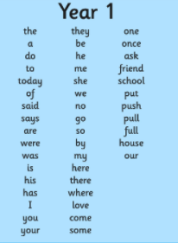
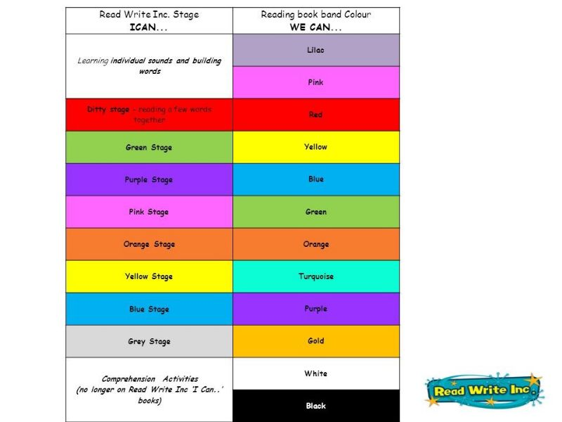
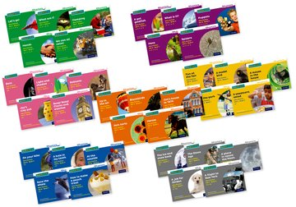
Autumn Term
English
Reading, Writing & SPAG

Slide 10
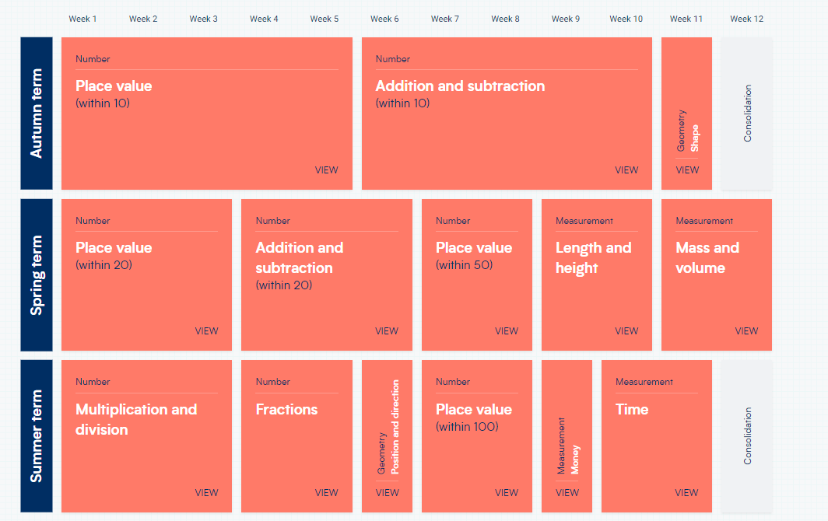
Autumn Term
Maths –Overview of the Year

Slide 11
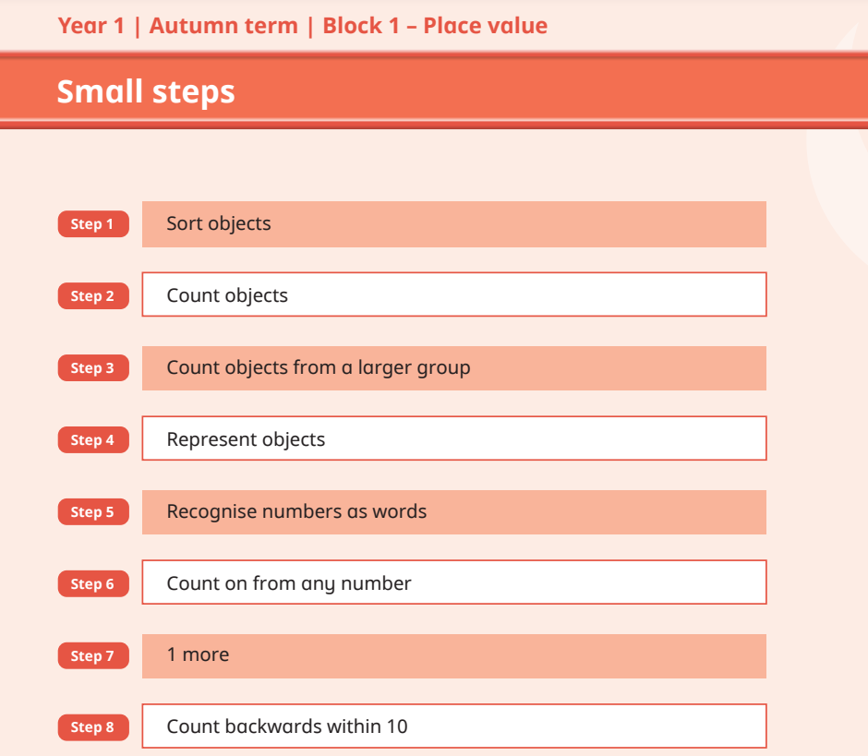
Autumn Term
Maths

Slide 12
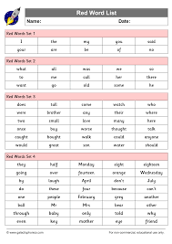
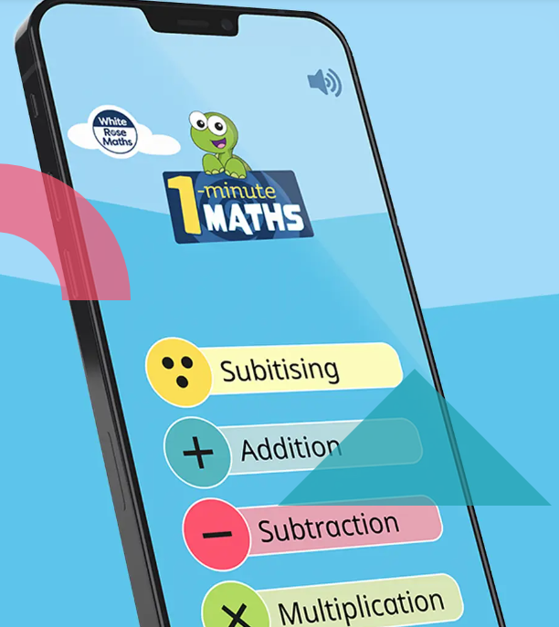
Year 1 Homework
Reading
Spelling
Maths

Slide 13
Year 3 Homework Expectations
Year 1 Homework
Homework projects sent at the beginning of each term to be completed by the end of each term.

Slide 14
Communication
http://www.millfields.hackney.sch.uk/

Slide 15
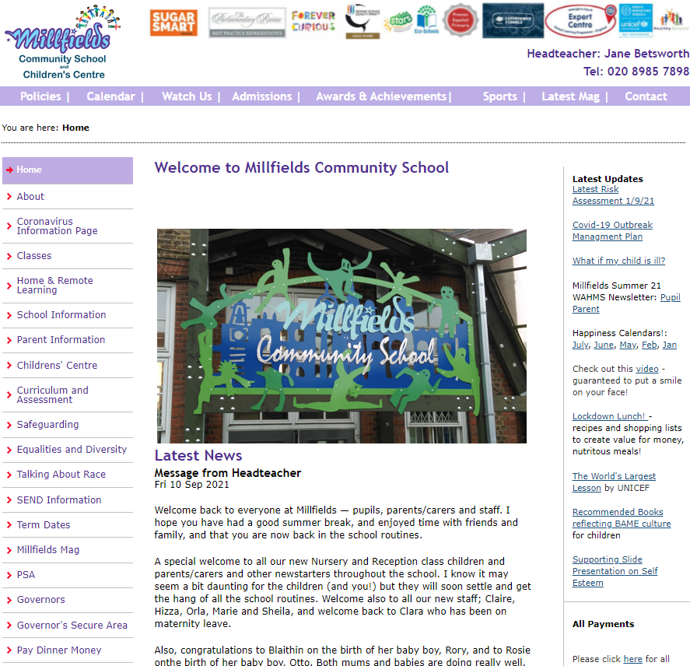
Millfields Website
http://www.millfields.hackney.sch.uk/

Slide 16
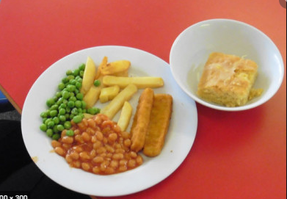
Lunches
Clubs
Please book and pay for school lunch or clubs

Slide 17
Important Dates
What? | When?
Lowry Class Assembly Lowry Forest School | Friday 14th October Wednesday 12th and 19th October
End of Autumn term 1 | 2:15pm on Friday 21 October.
End of Autumn term 2 | 2:15pm on Friday 16th December.

Slide 18
Questions

